Slide 1
Social Psychology
Social influence

Slide 2
Syllabus
Explanations for conformity:
informational social influence
normative social influence

Slide 3
Informational Social Influence
When we do not know how to behave, we copy other people. They thus act as information sources for how to behave as we assume they know what they are doing. Also because we care a great deal about what others think about us, this provides a safe course of action—at the very least, they cannot criticize us for our actions. We are more likely to use this principle when the task in question is important to us. This leads to such effects as people ignoring public muggings and cult members being led into bizarre and even suicidal acts. Private acceptance occurs when we genuinely believe the other person is right. This can lead to permanent changes in beliefs, values and behaviours. Public compliance occurs when we copy others because we fear ridicule or rejection if we behave otherwise.

Slide 4
Informational Social Influence
Informational social influence (also called social proof) occurs most often when: The situation is ambiguous. We have choices but do not know which to select. There is a crisis. We have no time to think and experiment. A decision is required now! Others are experts. If we accept the authority of others, they must know better than us. In other words, when we are not sure of our own ability to know what to do, we will look to others to tell us.
Police often find themselves in situations of ambiguity and crisis. People will naturally turn to the police for advice in such situations.

Slide 5
A bit of fun
Using it Get the other person into a state of relative confusion where they are uncertain about what to do next, then lead them to where you want them to be. It works best if you go first, doing it. Telling them what to do can also be effective, but requires them to accept you as an authority. For permanent change, precede this by sufficient work that they trust you completely and view you as an authority with enviable values and beliefs. Defending When the situation is ambiguous or in crisis, do not just look to other people (who may well be looking to you). In particular, beware of people who set themselves up as an authority without adequate proof (and a white coat or commanding attitude is not proof). Know that you always have individual choice, just as you have individual responsibility for your own actions. In any situation, you always have common sense available to you. Do not abandon it.

Slide 6
Sheriff
https://www.youtube.com/watch?v=rlqblFD--WQ

Slide 7
Sheriff
Repeated Measures: The same participants take part in each condition of the independent variable. This means that each condition of the experiment includes the same group of participants.
  Pro: Fewer people are needed as they take part in all conditions (i.e. saves time)
  Con: There may be order effects. Order effects refer to the order of the conditions having an effect on the participants’ behavior. Performance in the second condition may be better because the participants know what to do (i.e. practice effect). Or their performance might be worse in the second condition because they are tired (i.e. fatigue effect).

Slide 8
Sherif’s research (Informational social influence)
Autokinetic effect = stationary spot of light in a darkened room, then very small movements of the eyes make the light seem to move.
In Sherif’s key condition, the p’s were 1st of all tested 1 at a time, and then in small groups of 3. They were asked to say how much the light seemed to move, and in what direction.
When 3 individuals with very different personal norms were then put together into a group, they tended to make judgements that were very close to each other.
Sherif (1935) also used a condition in which individuals started the experiment in groups of 3, and then were tested on their own. Once again, a group norm tended to develop within the group. When the members of the group were then tested on their own, their judgements concerning the movement of the light continued to reflect the influence of the group

Slide 9
Normative Social Influence
There is a fundamental human need to belong to social groups. Evolution has taught us that survival and prosperity is more likely if we live and work together. However, to live together, we need to agree on common beliefs, values, attitudes and behaviours that reduce in-group threats act for the common good. We thus learn to conform to rules of other people. And the more we see others behaving in a certain way or making particular decisions, the more we feel obliged to follow suit. This will happen even when we are in a group of complete strangers. We will go along with the others to avoid looking like a fool. However the forces are strongest when we care most about respect and love from others in the group. Thus families and friends can apply very strong normative influence. People with lower self-esteem and who crave approval of others may well be more easily influenced this way. When a person in a group does not conform, then they may be considered a deviant and both private and public advice may be given to them on how to fit in. If they still do not obey norms, they will eventually be ejected and membership of the group revoked. National culture also has a significant effect, and people in countries like Japan, who have collectivist cultures, are far more likely to be influenced than in more individualistic cultures, such as in the USA (although it is a testament to the power of this effect that it still has a massive impact here).

Slide 10
Normative Social Influence
Solomon Asch showed a group of people a line on a card and asked them to find a matching line from a group of three lines on another card, one of which was pretty obviously the right choice. The catch was that all except one person in the group were collaborators and chose the wrong line. When it came to the ‘victim’s turn, guess what? In a range of experiments, 76% of them followed suit. The presence of just one supporter reduced this to 18%.
Fads and fashions lean heavily on normative social influence. So do racial, political and other situations of persuasion.

Slide 11
A little bit of fun
Using it To change a person’s behaviour, put them in a group who (perhaps primed) clearly all exhibit the desired behaviour. Then engineer the situation so the person must exhibit the behaviour or face potential rejection or other social punishment. If they do not comply, ensure the group gives steadily increasing social punishment rather than rejecting the target person immediately. When they do comply, they should receive social reward (eg. praise, inclusion). Defending Where you want to do something and the group in which you currently are socially punishes you for doing it, make a conscious decision as to whether it is worth fighting back or just giving up and leaving. If they mean nothing to you, just carry on and ignore them. It can also be very heartening to watch other people resisting (and your doing so may well give heart to other doubters). You can also acquire idiosyncrasy credits, where the group puts up with your eccentricities. To do this, be consistent in what you do, whilst also showing that in doing so you are not threatening the integrity of the group.

Slide 12
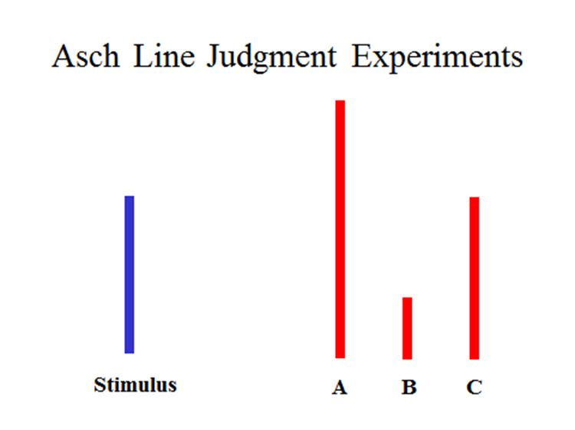

Slide 13

Solomon Asch:
Compliance in an
Unambiguous
Situation

Slide 14
Asch’s research (Normative social influence)
7 male, student participants looked at two cards: the test card showed one vertical line; the other card showed three vertical lines of different length. The participants’ task was to call out, in turn, which of these three lines was the same length as the test line. The correct answer was always obvious.
All participants, except one, were accomplices of the experimenter. The genuine participants called out his answer last but one.
Accomplices gave unanimous wrong answers on 12 of the 18 trials. These 12 trials were called the critical trials.
In total, Asch used 50 male college students as naïve, genuine participants in this first study. Participants conformed to the unanimous incorrect answer on 32% of the critical trials. This might not strike you as a very high figure but remember the correct answer was always obvious. 74% of participants conformed at least once.

Slide 15
Informational
Informational Social Influence is where a person conforms to gain knowledge, or because they believe that someone else is ‘right’.
The desire to be right – when we conform because we are unsure of the situation or lack knowledge, so we look to others who we believe may have more information than us. This explanation tends to lead to internalisation.
Look at Jennes experiment and criticise.

Slide 16
Normative social influence
Individuals want others to like and respect them and not reject or ridicule them. This is the motivation underpinning NSI; the need to be accepted by others and the best way of gaining the acceptance of others is to agree with them. However, this does not necessarily mean that we truly agree with them.
Evaluate Asch experiment.

Slide 17
EVALUATION:
Historical validity – It is possible that Asch’s findings are unique because the research took place in a particular period of US history when conformity was high. In 1956, the US was in the grip McCarthyism, a strong anti-Communist period when people were scared to go against the majority and so more likely to conform.
Population validity – All of the participants were male and so the results cannot be generalized to females.
Independent variable rather than conformity – You have to remember that only about one-third of the trials where the majority unanimously gave the same wrong answer produced a conforming response. In other words, in two-thirds of these trials the participants resolutely stuck to their original judgement despite being faced with an overwhelming majority expressing a totally different view. Asch believed that rather than showing human beings to be overly conformist, his study demonstrated a commendable tendency for participants to stick to what they believed to be the correct judgement, ie: show independent behaviour.
Ecological validity – You must remember that this study was a lab experiment and so is difficult to generalise to other situations and real-life experiences as various extraneous variables were controlled.
Unconvincing confederates – One problem was that the confederates found it difficult to act convincingly when giving the wrong answer, which could affect the internal validity of the study.

Slide 18
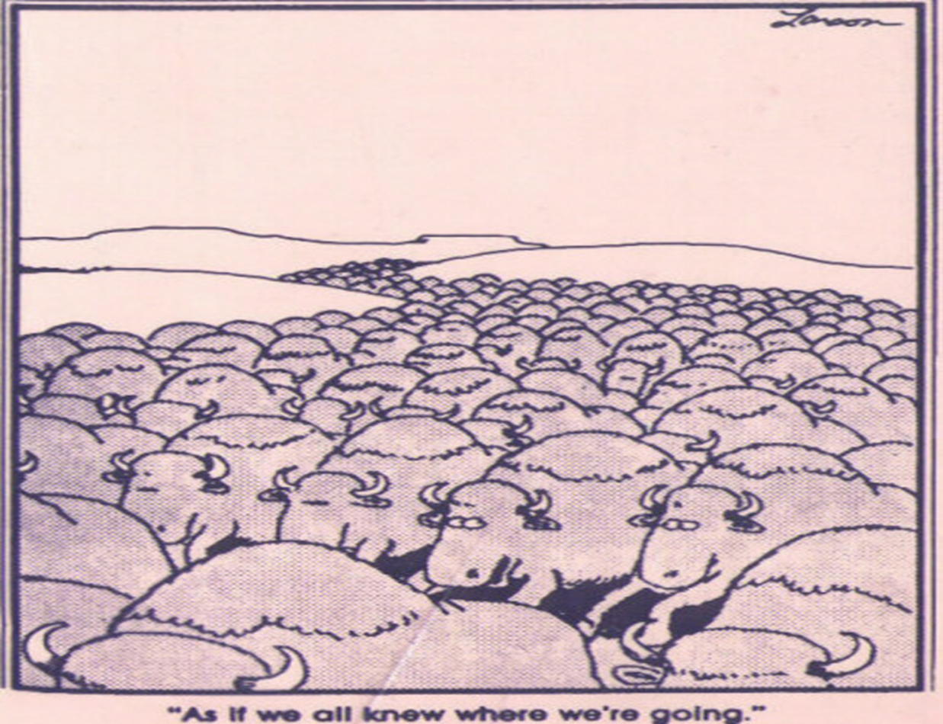

Slide 19
Syllabus
Internalisation
Identification
Compliance

Slide 20
Internalisation
Internalisation is the deepest level of conformity. Here a person changes their public behaviour and their private beliefs. This is usually a long-term change and often the result of informational social influence (ISI). For example, if an individual is influenced by a group of Buddhists and converts to this faith, then their new religious way of life will continue without the presence of the group and they have internalised this belief.

Slide 21
Identification
Identification is the middle level of conformity. Here a person changes their public behaviour and their private beliefs, but only while they are in the presence of the group. This is a usually a short-term change and normally the result of normative social influence. For example, a person may decide to become a vegetarian because all of his new flat mates are vegetarian. However, whenever he walks past a MacDonald’s he can’t resist a Big Mac and when he is away from his flat mates he still eats meat. Identification takes place we are surrounded by a particular group; we change our private beliefs while in the presence of the group and not permanently.

Slide 22
Compliance
Compliance is the lowest level of conformity. Here a person changes their public behaviour, the way they act, but not their private beliefs. This is usually a short-term change and is often the result of normative social influence. For example, you might say that you like dub-step music because many other people in your class like dub-step music and you wish to fit in, however privately you dislike this style of music.

Slide 23
Syllabus: Types of conformity
Internalisation
Identification
compliance

Slide 24
What is Conformity
Conformity is a change in behaviour or attitudes as a result of real or imagined group pressure or norms. Kelman (58) suggests that there are 3 kinds of conformity:
  Compliance- shallowest form of conformity: Private and public views are different
  Identification – conforming to a role because of identification with that role e.g. role of year 12 vs role of a year 13.
  Internalisation- deepest form of conformity: Private and public views change

Slide 25
Different types of Conformity
1
Compliance- personal views different from public view. Eg laughing at a joke that everyone is laughing at but not finding it funny.

Slide 26
2
Identification-
Changes views both publicly and privately to fit in. Identifies with a member of the group they admire. A recruit in the army.
This may be temporary

Slide 27
3
Internalisation
– taken on at a deep and permanent level. Sharing a flat with vegetarians and then continue to be a vegetarian for the rest of your life. Also called conversion

Slide 28
Non Conformity
Not everyone conform to social pressure. Indeed, their are many factors that contribute to an individual's desire to remain independent of the group.
For example, Smith and Bond (1998) discovered cultural differences in conformity between western and eastern countries. People from western cultures (such as America and the UK) are more likely to be individualistic and don't want to be seen as being the same as everyone else.
This means that they value being independent and self sufficient (the individual is more important that the group), and as such are more likely to participate in non conformity.
In contrast eastern cultures (such as Asian countries) are more likely to value the needs of the family and other social groups before their own. They are known as collectivist cultures and are more likely to conform.

Slide 29
Minority Influence
12 Angry men https://www.youtube.com/watch?v=xbb1QzQ9P1w

Slide 30
Syllabus
Minority influence including reference to consistency, commitment and flexibility

Slide 31
Minority influence
One of the most striking findings from using the Asch paradigm was the extent to which conforming responses are reduced if the participant is no longer isolated. Adding just one person who shares the individual’s judgement makes it much more likely that the participant will resist the pressure to conform from the majority. Resistance, however, is only one option for the individual (and his or her supporter) in such circumstances. They could go further than mere resistance and actively seek to change the majority’s viewpoint, attempting to convince them that they are wrong and that he or she is right. The French psychologist Serge Moscovici was one of the first researchers to study the conditions under which minorities can become an effective source of influence.

Slide 32
Explanations of minority influence
Moscovici (1976) argues that cases of minority influence and especially the influence of innovators such as Galileo and Freud, cannot be accounted for in the way that social psychology has traditionally explained majority influence. Minorities do not have the sanctions that can be used by majorities (punishment or rejection), they are few in number and often ridiculed at the outset. In other words they possess neither normative nor informational influence.
Moscovici proposes a dual process theory to explain the two forms of social influence. Majority influence, according to Moscovici can best be explained in terms of public compliance (the person is more concerned with the reaction of the group than to the issue itself). Minority influence is the result of the majority being persuaded to examine the minority’s viewpoint. This may start a process of conversion where attitudes begin a genuine shift. Because it is a genuine conversion, minority influence is longer lasting. In contrast, public compliance as a result of majority influence may not change the individual’s private viewpoint and they will revert to this once released from normative influence.
Their source of impact results from what Moscovici calls behavioural style, the most important aspects of which are consistency. Only if minority members are consistent, i.e. agree amongst themselves (at least publicly) and continue to do so over a period of time, will they be able to make the majority begin to question their position and open the way to being influenced.

Slide 33
12 Angry men
Nemeth (1986) has offered a cognitive explanation of minority influence. To explain the effect of a consistent majority, she suggests that a minority within a group that consistently disagrees has the effect of changing what the majority pays attention to and encouraging new ways of thinking. Majority influence tends to produce convergent and unimaginative thinking as people merely imitate the ideas of others. The presence of a dissenting voice may encourage people to think more laterally and creatively. In the case of juries, for example, attending to the minority view can result in paying closer attention to the details of the case and finding new ways of interpreting the evidence. This is exactly what happens in ‘Twelve Angry Men’.

Slide 34
Variables affecting conformity
Group size
Unanimity
Task difficulty as investigated by Asch
Conformity to social roles as investigated by Zimbardo.

Slide 35
Group Size
Group size – Asch found that there was little conformity when the majority consisted of juts one or two confederates. However, under the pressure of a majority of 3 confederates the proportion of conforming responses jumped up to about 30%. Further increases in the size of the majority did not increase this level of conformity substantially, indicating that the size of majority is important, but only up to a point.

Slide 36
Unanimity
Unanimity of the majority – When the real participant was given the support of either another real participant or a confederate of their own, conformity levels dropped from 33% to just 5.5%.

Slide 37
Difficulty of the task
Difficulty of the task – When Asch manipulated the lines so that the test was much harder the level of conformity increased.

Slide 38
Test Question
Outline and evaluate research into conformity. (12 marks)

Slide 39
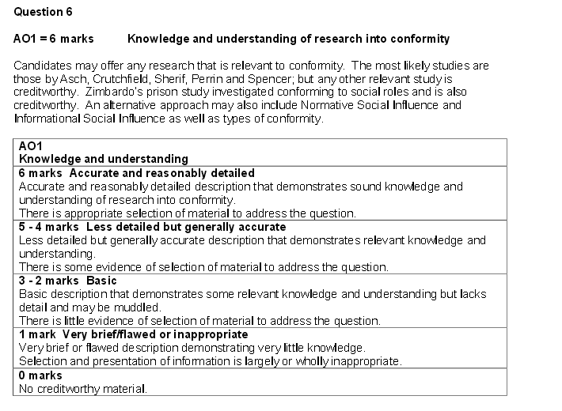

Slide 40
Extras
Crutchfield (1954) criticized Asch that the type of experiment undertaken by Asch is very time consuming, as only one person can be tested at a time. Richard Crutchfield decided to change the experimental method so that several people, usually five, could be tested simultaneously. The same kind of problem as Asch used, was used. Each participant sat in a booth with an array of lights and switches in front of them. They were told to give their answers and each were told that they were last to guess and the others guesses were indicated by the lights on the panel. However each participant was actually given the same display, which on about half the trials was actually incorrect. Crutchfield aimed to find out whether people conformed to unambiguous tasks when the pressure from others was more imagined than real. Crutchfield found that 37% conformed all of the time but 46% some of the time. The results found were really similar to Asch's but had a lower conformity rate. This concluded that there is conformity to imagined pressure. The experiment was criticised to have specific people used that were perhaps more conforming. Also it lacked external validity. The time the experiment was done in (1950's) was generally a more conforming time, so that could have been one of the reasons why the people conformed more. This experiment was also thought to be unethical as the participant were lied to and could have been embarrassed.

Slide 41
Extras
Perrin and Spencer (1980) tried to repeat Asch's study in England in the late 1970s. They found very little evidence of conformity, leading them to conclude that Asch's effect was a 'child of its time'. However the low levels of conformity found in Perrin and Spencer’s study may have occurred because they used engineering students who had been given training in the importance of accurate measurement and therefore had more confidence in their own opinions.

